Slide 1
Amazon Product Review & Sales Insights – Capstone Project
Farahnaz Pierre-Isme – Aspiring Data Analyst

Slide 2

Introduction : About Me
Who Am I
Aspiring Junior Data Analyst with a background in healthcare operations and customer relations
Passionate about uncovering insights from complex datasets and improving business decisions
Experienced in handling patient data, customer feedback, and operational metrics
Skills & Tools
Technical: SQL, Excel, Tableau, Data Cleaning, Data Visualization
Analysis: Trend analysis, KPI reporting, dashboard creation, pivot tables
Soft Skills: Communication, problem-solving, stakeholder collaboration, leadership, attention to detail
What I Bring
Strong attention to detail and ability to translate raw data into actionable insights
Blend of analytical skills and real-world business understanding (healthcare + e-commerce)
Curiosity and commitment to continuous learning in data analytics

Slide 3
Project Overview
Amazon Product Review Dataset from Kaggle
Cleaned Amazon product review dataset (Excel + SQL)
Analysis & KPI’S:
Average rating by price tier
Review volume trends over time
Top 10 products by sales & ratings
Tools Used: Excel, SQL, Tableau, GitHub

Slide 4
Ask- Define the Business Question
Key Question: What insights can be drawn from Amazon product reviews and sales data to improve decision-making?
Which products have the highest/lowest sales?
How do customer ratings impact product performance?
What trends exist in review volume and sentiment over time?

Slide 5
Problem Statement
Amazon Sellers struggle to understand how customer review and ratings impact product sales performance, making it difficult to identify strategies that drive both revenue growth and customer satisfaction.
Deliverable Business Task: Understand how reviews, ratings, and price tiers affect customer behavior
Value: Helps Amazon improve product strategy and customer trust

Slide 6
Prepare- Data Collection
Data Source: Kaggle Amazon Product Review Dataset (Sales + Ratings + review text)
Format: CVS files
Tools Used: Excel, SQL, Tableau
Initial Issues Found:
Inconsistent product categories
Missing values in ratings & reviews
Duplicate product categories
Large dataset size requiring filtering
Notes:
Prepare phase: I collected the Amazon review and sales dataset from Kaggle. The raw data came in CSV format, which I imported into Excel and Sql for organization. I also prepared it for visualization in Tableau . Early on I noticed serval challenges , including missing values, duplicate product entries, and inconsistent categories. Preparing this data was a crucial step to ensure accurate analysis later in the project,

Slide 7
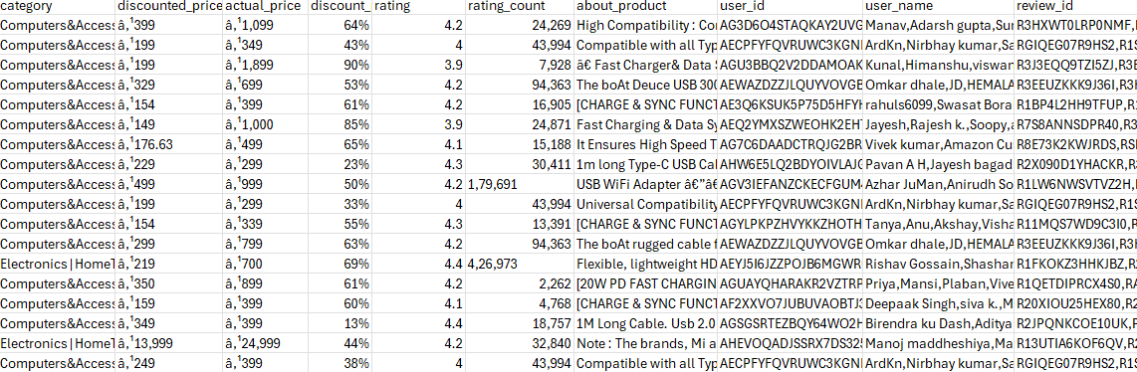
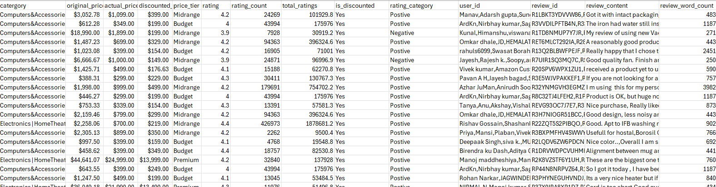
Process-Data Cleaning & Preparation
Messy Data
Data Cleaning Task:
Removed duplicates and missing values
Handled missing values (filled or excluded)
Standardized price tiers (low, mid, high)
Data Transformation:
Created calculated fields (review month, review length, avg rating)
Aggregated sales & reviews by product and category
Filtered out irrelevant or incomplete records
Tools Used: Excel, SQL
Clean Data
Notes:
I focused on cleaning and transforming the dataset to prepare it for accurate analysis. I started by removing duplicate product entries and handling missing values, either filling them where possible or excluding incomplete rows. I also standardized inconsistent product categories to make sure comparisons were accurate. Next, I created calculated fields like review length and average rating, which allowed me to explore patterns in customer feedback. I aggregated sales and reviews by product and category to get a clearer view of overall performance. Finally, I filtered out irrelevant records to keep the dataset focused on meaningful insights. This cleaned dataset became the foundation for my Tableau visualizations in the analysis phase

Slide 8
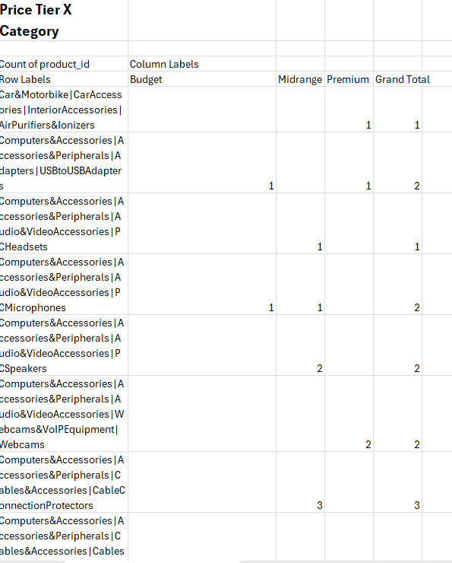
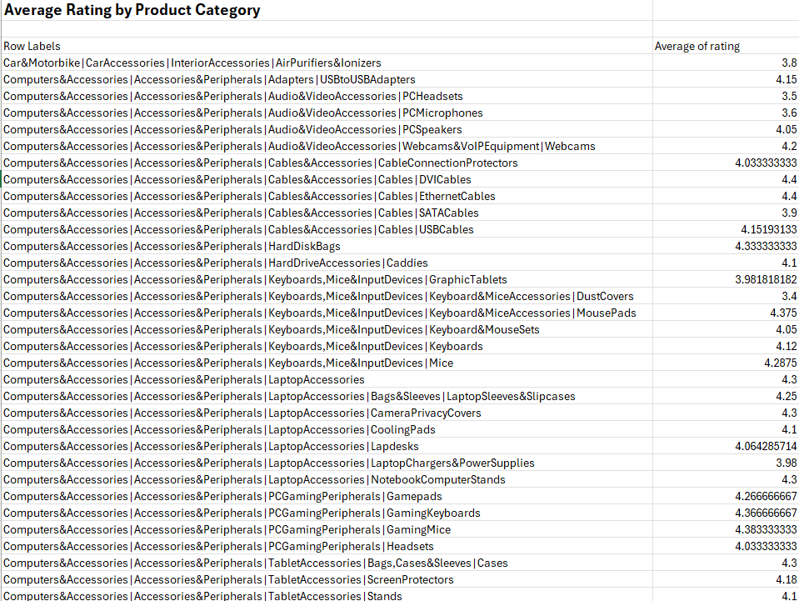
Analyze
Exploratory Analysis:
Identified Top 10 products by sales and rating
Measured review volume trends over time
Analyzed relationship between rating and sales
Key Findings:
Products with higher ratings (4–5 stars) consistently show higher sales
Review volume spikes align with holiday seasons
Longer, detailed reviews often correlate with higher customer satisfaction
Tools Used: Pivot Tables (Excel), SQL Queries, Tableau
Notes:
Ran SQL queries for product performance
Used Excel pivot tables for trends
Identified key patterns in reviews & pricing

Slide 9
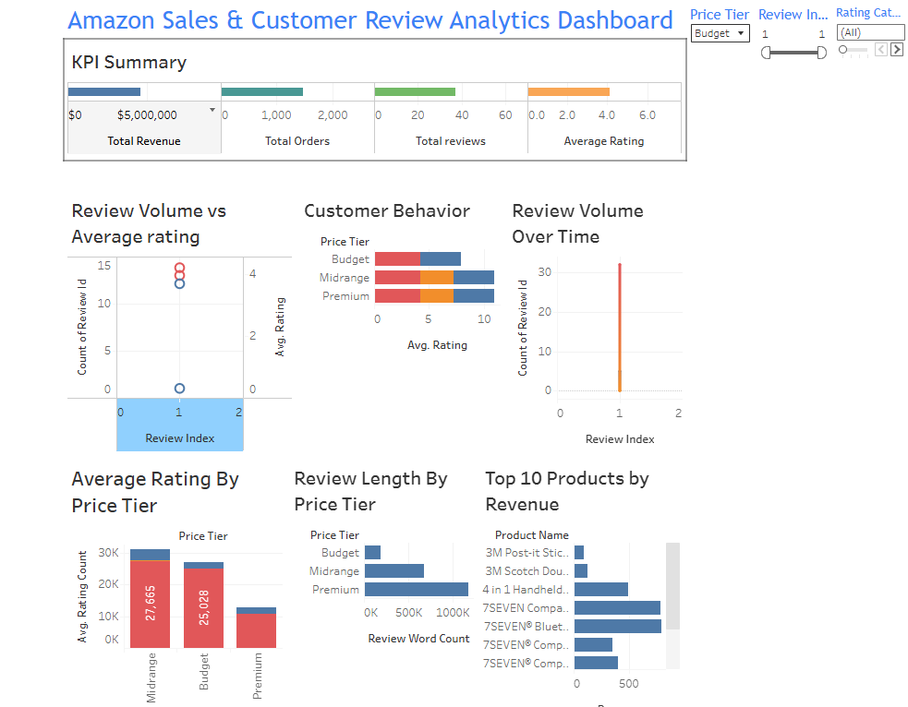
Share – Visualization Insights
Tableau Dashboard Highlights:
KPI Summary Sheet (Revenue, Avg. Rating, Review Volume)
Review Trends Over Time
Customer Behavior Insights (Review length vs rating)
Top 10 products by sales & ratings

Slide 10
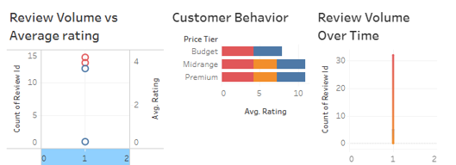
Data Visualization – Key Insights
1) Customer Engagement
Review volume peaked during holiday and discount periods
Seasonal buying trends are strong
2) Product Ratings
Mid-range priced products ($50-$150) earned the highest ratings.
Discounted products attracted more reviews and positive sentiment.

Slide 11
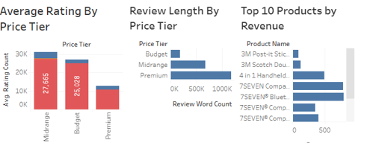
Data Visualization – Key Insights
3) Review Behavior
Longer reviews often signal dissatisfaction
Shorter reviews are tied to higher ratings and quick feedback
4) Top Products
A small set of products drive most of the engagement.
These products act as “brand leaders” in their categories

Slide 12
Act- Recommendations
Leverage Promotions
Run targeted discounts around holidays to maximize review volume and sales
2) Highlight Mid-Range Products
Feature mid-priced, high-rated products in marketing campaigns
3) Monitor Review Lengths
Set alerts for unusual long reviews to catch customer issues early.
4) Boost Popular Products
Prioritize advertising and stock levels for the top 10 products
Use them as an anchors to draw customers into relate categories

Slide 13


Final Takeaway
Key Insights from Analysis:
Top-rated products correlate with higher sales in certain categories
Review volume over time highlighted seasonal purchasing trends
Products with longer reviews often provide deeper customer sentiment insights
Identified price tiers impacting customer behavior and review patterns
What I Would Do Differently:
Perform more advanced sentiment analysis on reviews for richer insights
Include additional features like product categories, promotions, and shipping times
Use predictive analytics to forecast sales trends based on historical data
Refine Tableau dashboards for even more interactive storytelling for stakeholders

